Slide 1

Notepad Application - Trunica
Raj Desai, David O. Nwagbuo, Antoninus Lamptey
Department of Computer Science and Engineering
University of South Florida
Tampa, FL 33620
rajdesai@mail.usf.edu, nwagbuo@mail.usf.edu, antoninus@mail.usf.edu
1 of 15

Slide 2
Acknowledgments
Thanks to Dr. Kenneth Christensen, who provided valuable advice and helped us think of unique ideas relating to our project.
Thanks to Mr. Brad Lawrence, CEO of Trunica
Sources Used for Project:
www.w3schools.com
www.tutorialpoint.com
2 of 15

Slide 3
Agenda
Background
Problem and requirements
Solution (demonstration)
Design
Implementation
Summary and future work
3 of 15

Slide 4
Background
What is Cordova?
A mobile application development framework which enables users to create applications for mobile devices using CSS, HTML5, JavaScript which will be deployed on multi-platforms such as Windows, iOS, and Android.
What is Geolocation?
Geo-location has essentially the same function as a radar where it identifies the real-world geographic location of any specific object. It would also provide the correct positioning of where a specific item is found.
What is WebSQL?
A web page API which is used for storing data in databases. WebSQL is used as the local database for our application.
What is Azure?
A cloud computing platform created by Microsoft. Azure is used as the remote database for our application.

Slide 5

Problem
“How can we know what other people have noted at a specific location?”

Slide 6
Requirements
1. To develop a mobile application in Apache Cordova that will function as a notepad.
2. Each note should have a location (geo-tag) attached to it.
3. The application will have a privacy lock where the user decides whether or not to allow other users at a given location to access their notes.

Slide 7
Requirements cont.
4. The notes saved in the notepad application would be pushed to the cloud (Azure cloud database).
5. Users should be able to access any notes in a given radius of 1-30 miles.
6. The user should be able to write the note from anywhere and attach any location to it.

Slide 8
Design/Specification
Development Environment:
Apache Cordova
Visual Studio 2015
Languages/Databases:
HTML And CSS
JavaScript
SQLite
WebSQL
Microsoft Azure

Slide 9
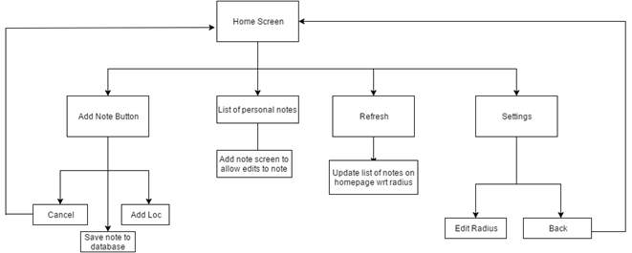
Design/Specification
The main problem of this project can be split up into 3 separate modules:
Creating and attach a location to that note.
Publishing the note to a cloud.
Retrieving note with attached location.

Slide 10
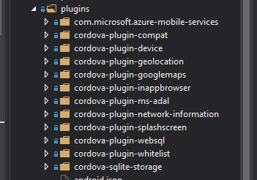
Design/Specification cont.
Figure 1: A screenshot of the plugins that were utilized to design the application.

Slide 11
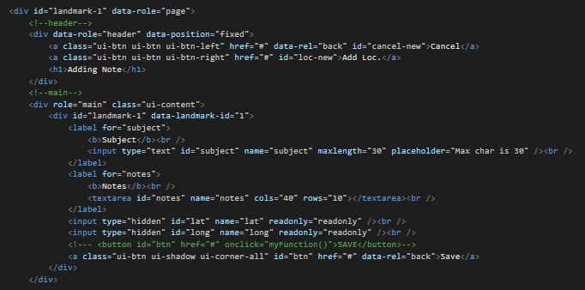
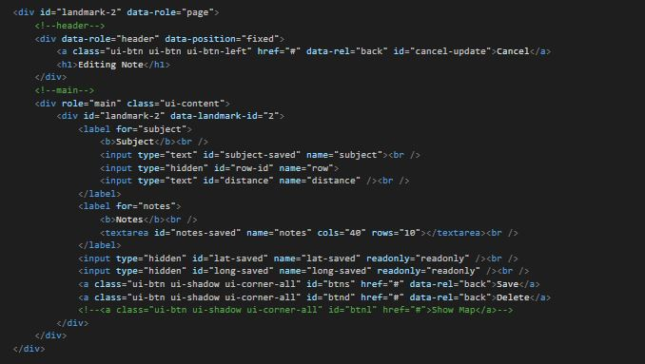
Implementation
Figure 2: This segment of code shows the implementation of adding a new note.
Figure 3: This segment of code shows the implementation of editing a currently existing note in the user’s application.

Slide 12
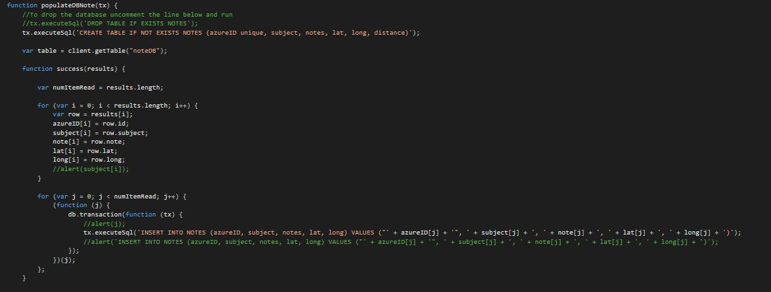

Implementation (cont.)
Figures 4 & 5: Both of these segment of codes show the implementation of the local and remote databases.

Slide 13
Summary and Future Work
Our app is serves many purposes
Note taking
Sharing of experiences
Location Targeting
Free to use
Possible Future additions:
Report System
Direct sending to people
Different forms of media for notes

Slide 14
Live Demonstration

Slide 15
Thanks for watching!

